Slide 1
Cost Distribution API
A solution by Pavlos Sakoglou, M.Sc.

Slide 2
Outline
Domain Background
System Design
Implementation
Intelligent features
Demo
Q&A

Slide 3
Problem Statement
We want to distribute cost to subsidiaries given an invoice
We need an automated system to do the following:
Get an invoice as input
Extract information from the invoice
Determine the subsidiaries this invoice refers to
Distribute cost to these subsidiaries
Update cost database and ledger
Report SUCCESS or FAILURE
We need a simple and intuitive Python API for the above system
We can then use or integrate this Python API to other software components

Slide 4
How the Python API will look like?
from roivant.accounting import cost
def submit_new_invoice(invoice_path):
# Create new Cost object to represent the invoice
# Load the invoice and extract the information
# Ask user to review the extracted information
if reviewed:
# Ask user to confirm
if confirmed:
# Submit cost to database appropriately and return SUCCESS
# If something went wrong, let the user know
# Discard invoice data and return FAILURE
invoice = toPDF(LedgerAPI.GET_NEWEST()) # Ledger GET method to be converted as valid input
if not submit_new_invoice(invoice): # Attempt to submit new invoice
# Do something

Slide 5
Python API documentation
/roivant/accounting/cost.Cost.Cost()
# Creates a new Roivant cost object
/roivant/accounting/cost.Cost.loadInvoice(invoice_path)
# Takes a string path to the invoice or an invoice object as input, extracts information about the invoice,
# and determines which subsidiaries are responsible for this expense proportionally. Allocates the cost appropriately
/roivant/accounting/cost.Cost.review()
# Triggers a display screen with all the extracted information and the distributed cost for review
# Returns true if confirmation is given, false otherwise
/roivant/accounting/cost.Cost.confirm()
# Asks for second confirmation after seeing the review screen, and returns true or false as per the confirmation

Slide 6
Python API documentation
/roivant/accounting/cost.Cost.submit()
# Updates the cost distribution database and saves the results.
# Returns true if submission is successful, false otherwise
/roivant/accounting/cost.Cost.throw()
# Displays a warning message with what went wrong.
# Optional: Logs the error, timestamp, invoice information, and employ who attempted submission
/roivant/accounting/cost.Cost.reset()
# Properly destroys the cost object

Slide 7
Additional API features for MIS
from roivant.accounting import view
stats = view.View() # instantiates a View object
stats.plotCostDistribution() # display total cost distribution among all *vants
stats.plotCostTable() # display total cost table
costs = stats.getCostTable() # get total cost table to use somewhere else
axovant = view.Axovant() # instantiate an Axovant view object
axovant.summary() # display the cost summary of Axovant
axovant.plotCostTable() # display total cost table of Axovant
datavant = view.Datavant() # instantiate a Datavant view object
datavant.printSummary() # connects to printer and prints total cost summary of Datavant
datavant.printCostTable() # connects to printer and prints total cost table of Datavant
# More functionality

Slide 8
Additional API features documentation
/roivant/accounting/view.View()
# Creates a new MIS object
/roivant/accounting/view.View.plotCostDistribution()
# Displays already computed statistics from data warehouse. Will plot in histograms and data pies historical cost and
# proportional expenses per subsidiary. Optionally, more information can be visualized
/roivant/accounting/view.View.plotCostTable()
# Displays and plots information from the general cost table of Roivant subsidiaries
/roivant/accounting/view.View.getCostTable()
# Returns the NxM data table of general cost of Roivant subsidiaries
/roivant/accounting/view.*vant()
# Creates a new MIS object for particular Roivant subsidiary, overriding MIS functionality + extra features
/roivant/accounting/view.*vant.summary()
# Displays a table with historical transactions and brief cost summary

Slide 9
Outline
Domain Background
System Design
Implementation
Intelligent features
Demo
Q&A

Slide 10
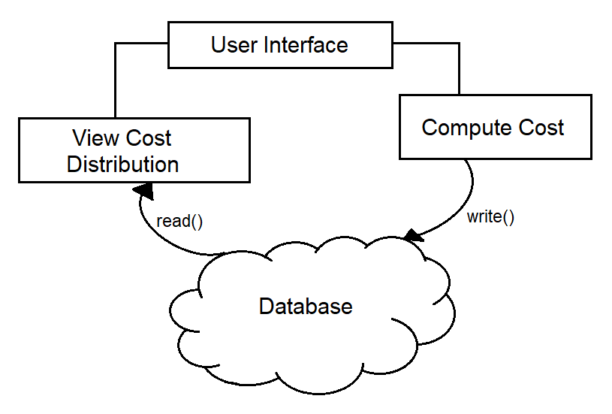
System design

Slide 11
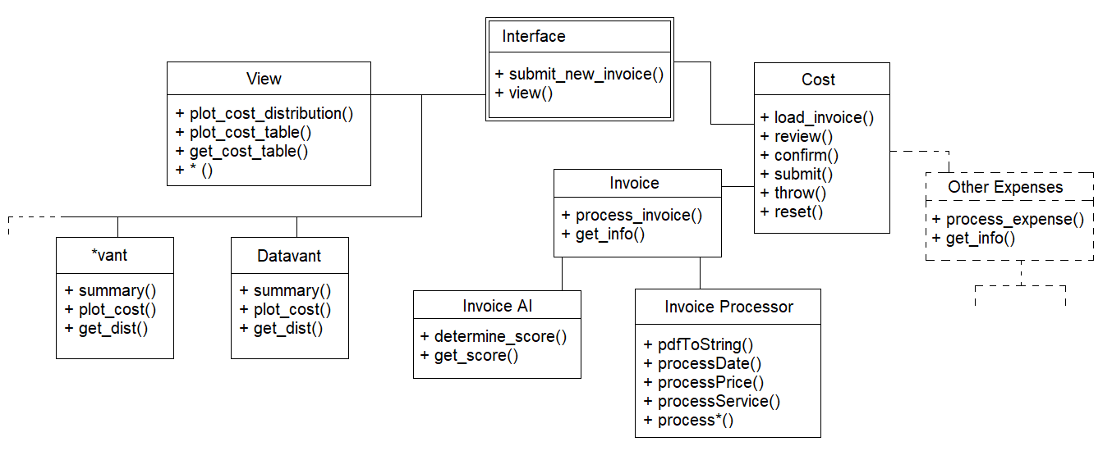
System design

Slide 12
System design
Source code structure
/roivant (root dir)
/accounting (child dir)
/cost.py
-> Cost()
-> loadInvoice()
-> review()
/invoice.py
-> Invoice()
-> process_invoice()
-> get_info()
/invoiceProcessor.py
-> pdfToString()
-> processDate()
-> …
/view.py
-> View()
-> *vant()
/…

Slide 13
Scalability / Maintenance
Minimum dependencies
Will work with different ledger software
Basic OS requirements and Python packages
Will support and work fast with a high volume of data
Choose a scalable data warehouse system
Easily extended to support more subsidiaries and their children
Easy to add new functionality or customize existing one
Intuitive API methods
Easy to use
Easy to learn

Slide 14
Pitfalls
Need to restructure invoices and other expenses into templated formats
Requires additional data warehouse system for fast data querying
More work to convert this into software suite i.e. C#, C++, etc.
Requires advanced AI and text recognition functions
Won’t work with any input invoice/cost doc format
Existing Software Integration challenges

Slide 15
Outline
Domain Background
System Design
Implementation
Intelligent features
Demo
Q&A

Slide 16
Implementation
Cost class (part 1)
# General Cost class
class Cost:
def __init__(self): # Constructor
self.invoice_info = [] # Encapsulates the invoice extracted data
def loadInvoice(self, invoice_path): # Loads and processes the input invoice
inv = invoice.Invoice() # Look at the Invoice class for the methods below
inv.processInvoice(invoice_path)
self.invoice_info = inv.getInfo()
print("Invoice loaded")
def review(self): # Confirmation screen
print("Please review the following:") # Displays the information again and asks user
for i in self.invoice_info:
print(i)
print("Press 1 when ready, 0 to cancel.")
return int(input())

Slide 17
Implementation
Cost class (part 2)
def submit(self):
addresses = self.invoice_info[-1]
t = time.time()
datestamp = str(datetime.datetime.fromtimestamp(t).strftime('%m-%d-%Y %H:%M:%S'))
price = self.invoice_info[0][1]
service = self.invoice_info[1][1]
date = self.invoice_info[2][1]
score = self.invoice_info[3][1]
conn = sqlite3.connect('RoivantDB.db')
c = conn.cursor()
for i in addresses[1]:
if i == 'Roivant':
c.execute("INSERT INTO Roivant (datestamp, service, price, date, score) VALUES(?,?,?,?,?)",
(datestamp, service, price, date, score))
conn.commit()
if i == 'Datavant':
c.execute("INSERT INTO Datavant (datestamp, service, price, date, score) VALUES(?,?,?,?,?)",
(datestamp, service, price, date, score))
conn.commit()
c.close()
conn.close()
print("Success!")

Slide 18
Implementation
Invoice class (part 1)
# Invoice class to objectify a new invoice
class Invoice:
def __init__(self): # Encapsulates all the invoice data of interest
self.price = 0.0 # that are meant to be copied in the database
self.service = ""
self.date = ""
self.score = 0.0
self.addresses = []
def processInvoice(self, pdf_path): # Function to process the invoice and assign
text = ip.pdfToString(pdf_path) # the extracted information to each invoice attribute
self.date = ip.processDate(text)
self.price = ip.processPrice(text)
self.service = ip.processService(text)
analysis = ai.InvoiceAI()
analysis.determineScore(text)
self.score = analysis.getScore()
self.addresses = ip.getAddresses(text)

Slide 19
Implementation
Invoice class (part 2)
# Function to return a list of the initialized
# invoice attributes
def getInfo(self):
return [ ["price", self.price],
["service", self.service],
["date", self.date],
["score", self.score],
["addresses", self.addresses] ]

Slide 20
Implementation
Invoice Processor file
def pdfToString(pdf_path): # Free function that reads a pdf and converts its contents
pdfFileObj = open(pdf_path, 'rb') # to a string of characters
pdfReader = PyPDF2.PdfFileReader(pdfFileObj)
pageObj = pdfReader.getPage(0)
return pageObj.extractText()
def processService(text): # Free function that reads the string version of the invoice
start = text.find("Service(s)") + 13 # and extracts the service from its location in the string
end = text.find("Point(s)") - 3
return text[start:end]
def getAddresses(text): # Free function that reads the string version of the invoice
''' Extract Subsidiaries' names ''' # and extracts the subsidiary companies that the invoice refers to
var1 = 'Roivant'
var2 = 'Datavant'
addresses = [var1, var2]
return addresses
# MORE FUNCTIONALITY ...

Slide 21
Outline
Domain Background
System Design
Implementation
Intelligent features
Demo
Q&A

Slide 22
Intelligent features
Cost inference with an Invoice AI system
Create a NLP algorithm to “read” parts of the invoice i.e. service, rationale, etc.
Classify invoice to an importance category
Compute importance/price ratio for the invoice
Compute and assign importance score and return a brief summary report

Slide 23
Intelligent features
Data mining
Plot cost distributions for each subsidiary
Plot historical cost data against their importance scores
Cluster cost categories and learn hidden segmentations of the expenses of each *vant
Use this information to classify new invoices and costs better
Visualization of the decision making on cost of each department

Slide 24
Outline
Domain Background
System Design
Implementation
Intelligent features
Demo
Q&A

Slide 25
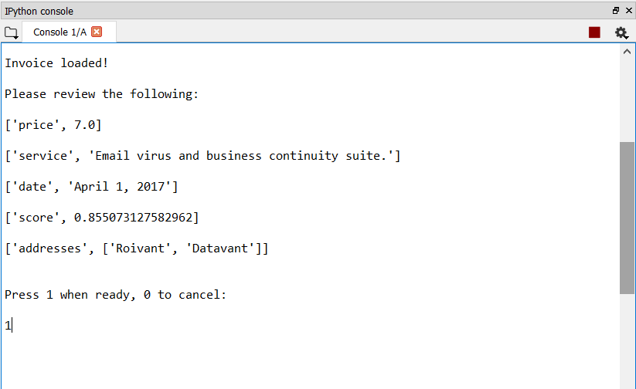
Demo

Slide 26
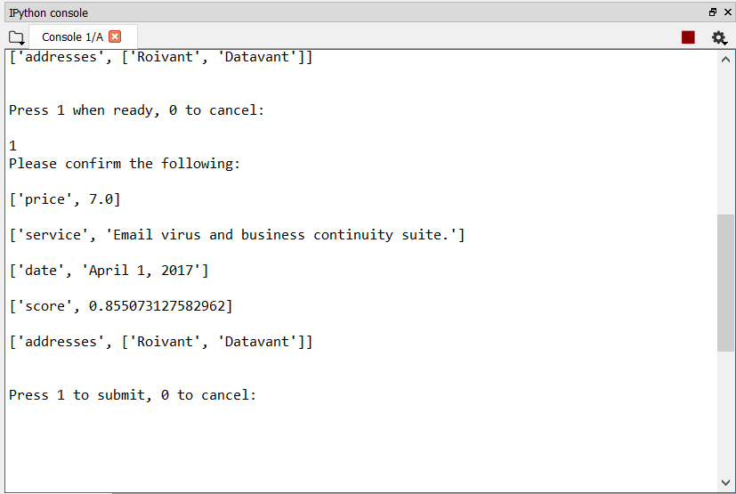
Demo

Slide 27
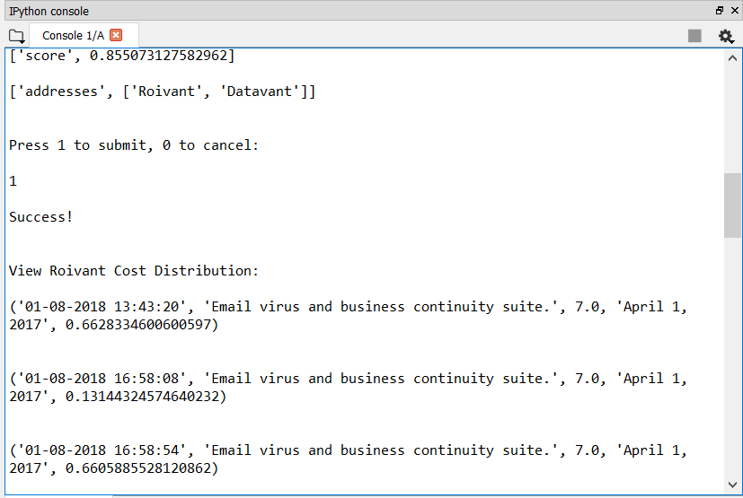
Demo

Slide 28
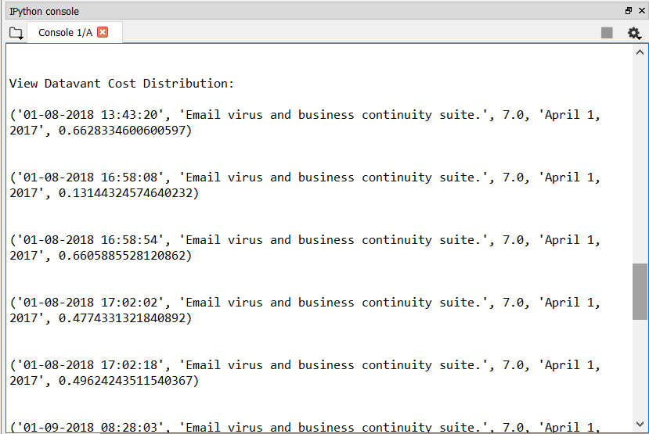
Demo

Slide 29
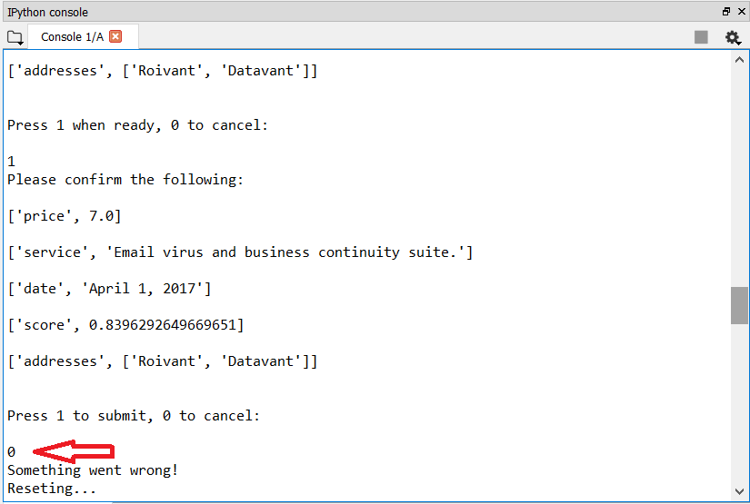
Demo

Slide 30
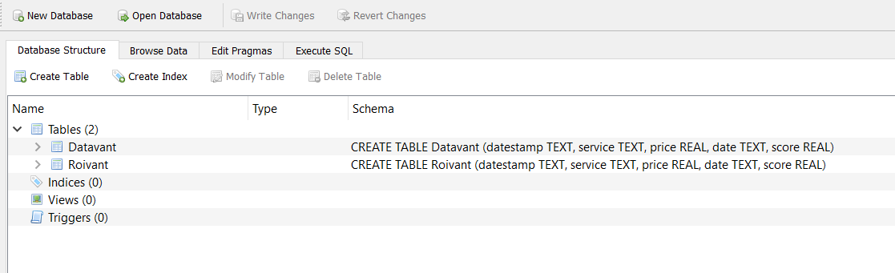
Demo

Slide 31
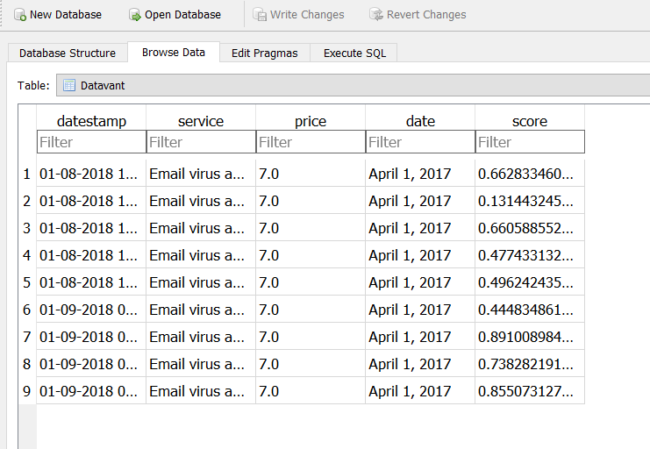
Demo

Slide 32
That is all!
Q&A

Slide 33
Thank you for your time!

